Slide 1
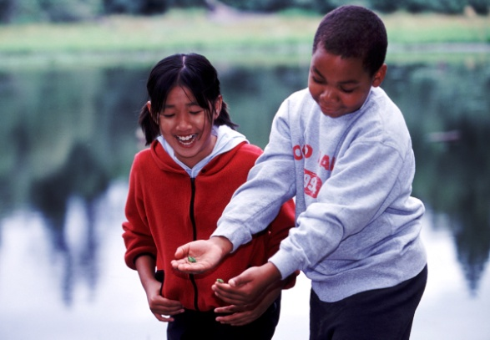
The Story of
Bainbridge Island, Washington, USA
Karen Salsbury, M.S.Ed
Faculty 2002-2017
Notes:
My name is Karen Salsbury, and I have been an educator for over 40 years. My work and joy has been teaching all ages, preschool to graduate school with my last 15 years focused on environmental education at IslandWood and graduate classes for the University of Washington. I am mostly retired now, and often host gatherings of my former students at our home on Bainbridge Island.

Slide 2
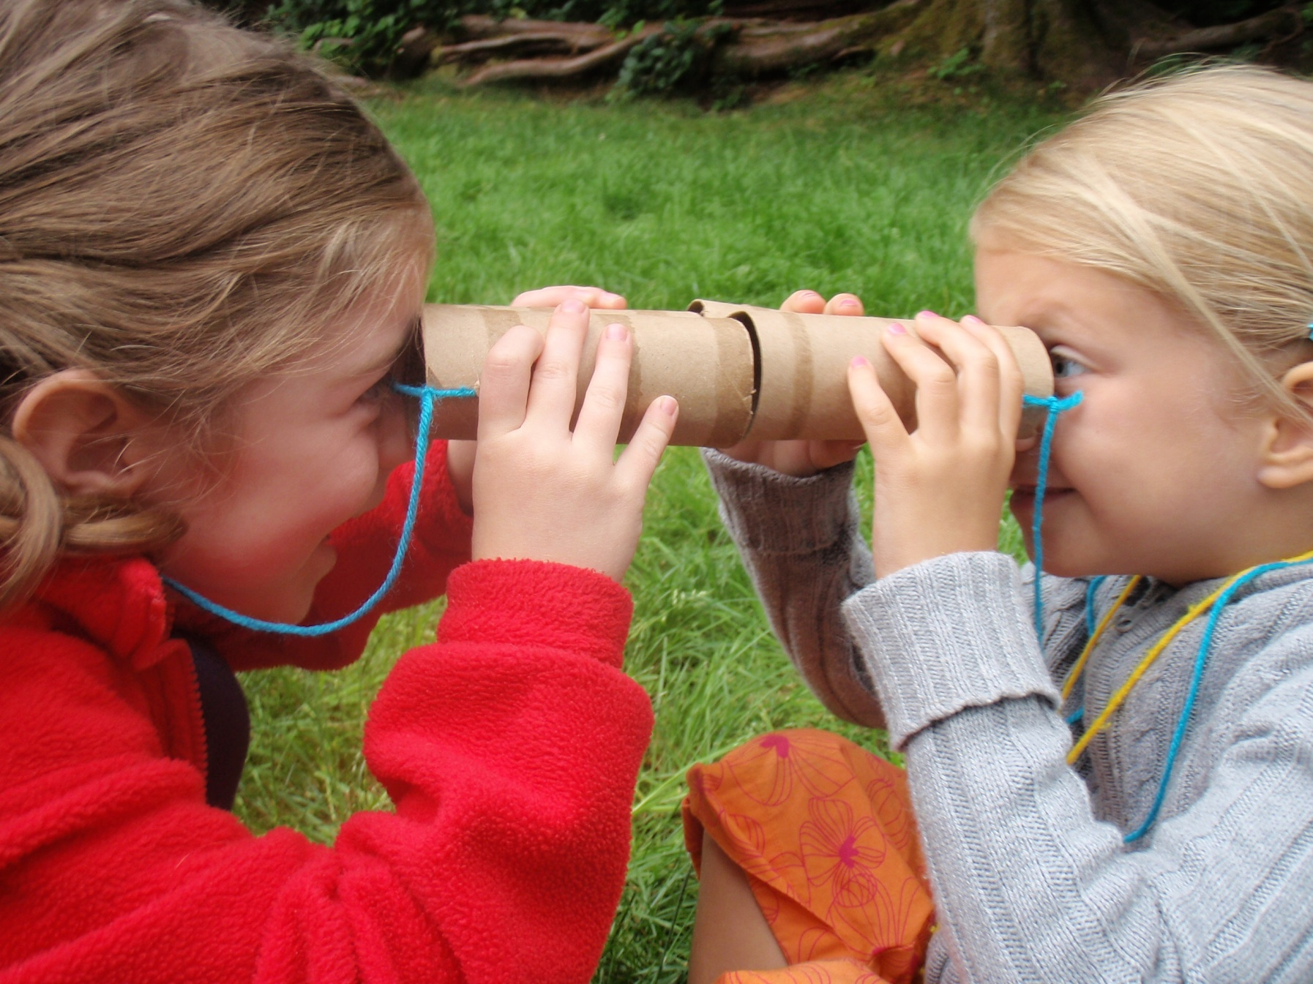
Where is IslandWood?

Slide 3
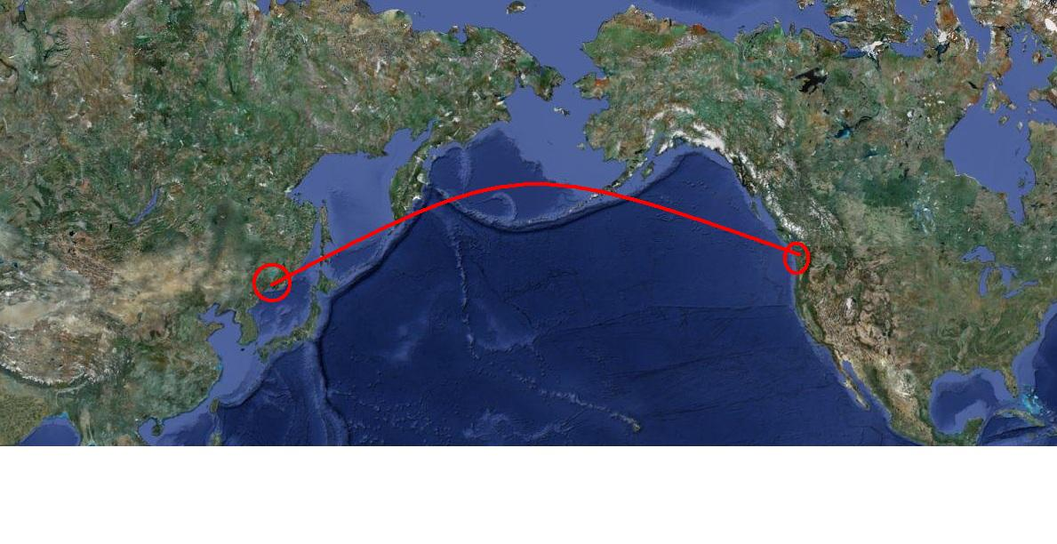
Across the Pacific Ocean from Russia…
Across the Pacific Ocean

Slide 4
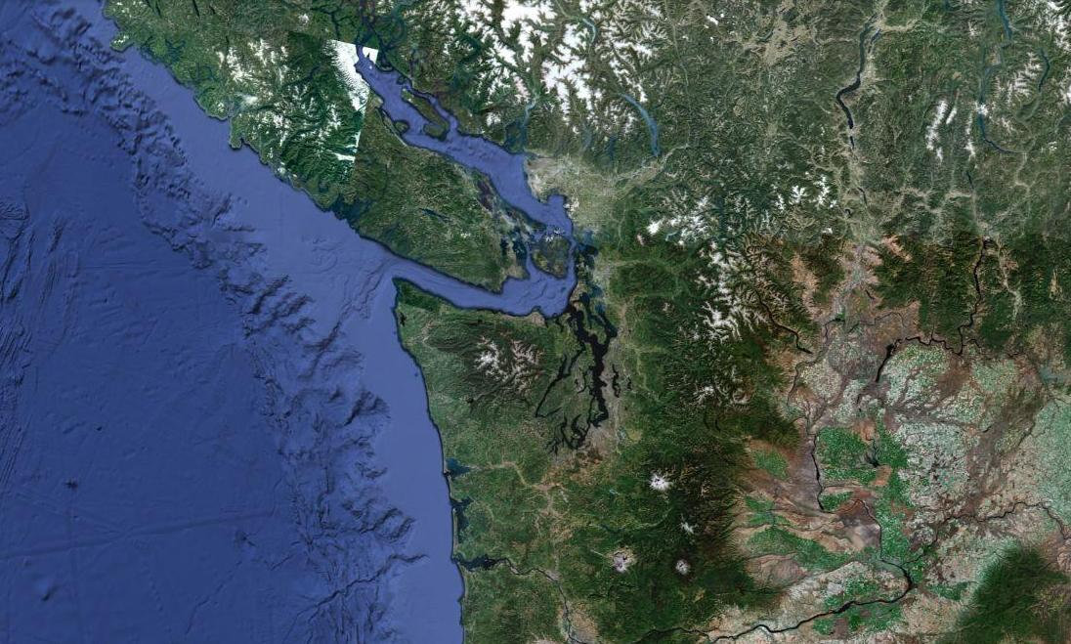
In the Pacific Northwest

Slide 5
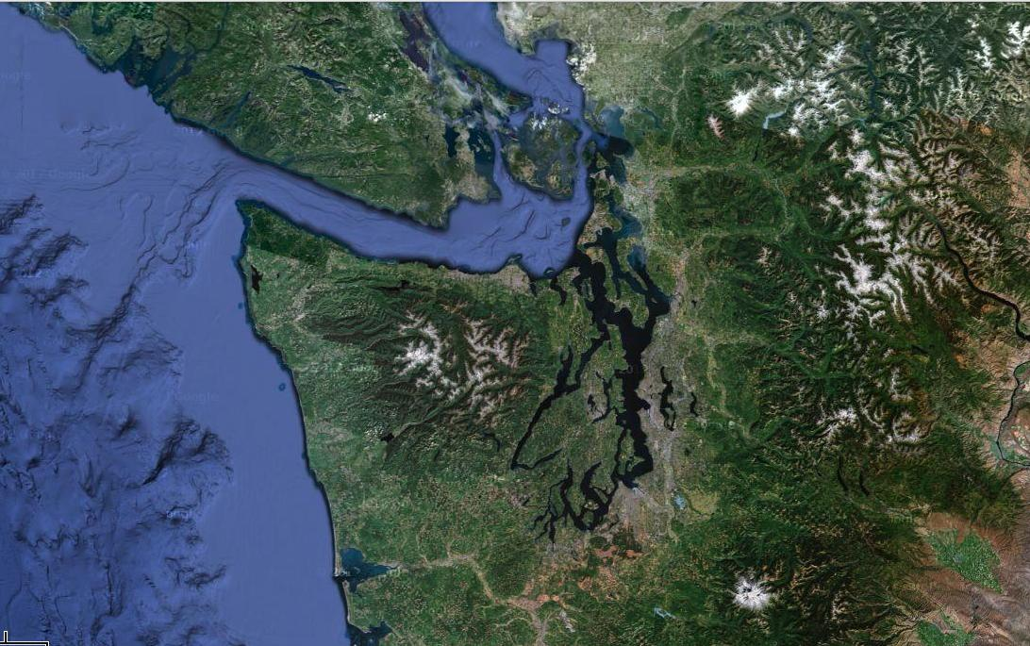
This is home to the Puget Sound,
Canada
Waters of Puget Sound

Slide 6
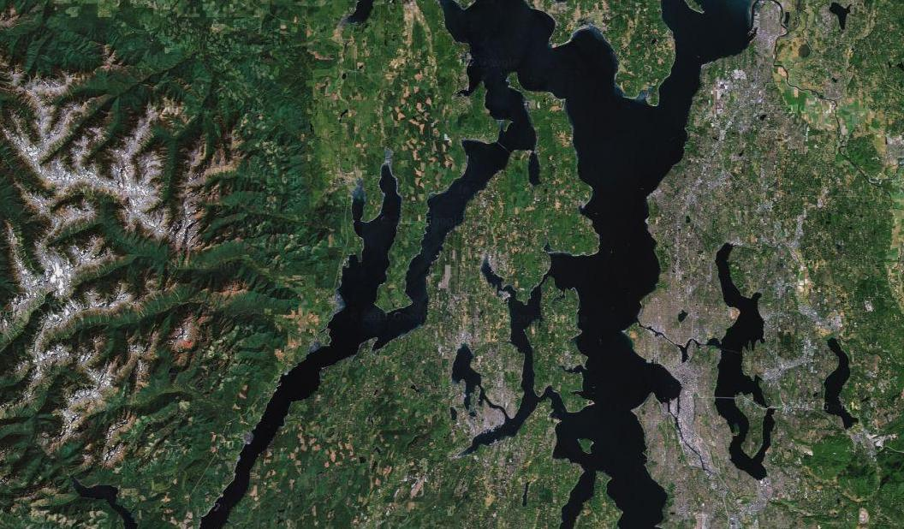
Bainbridge Island

Slide 7
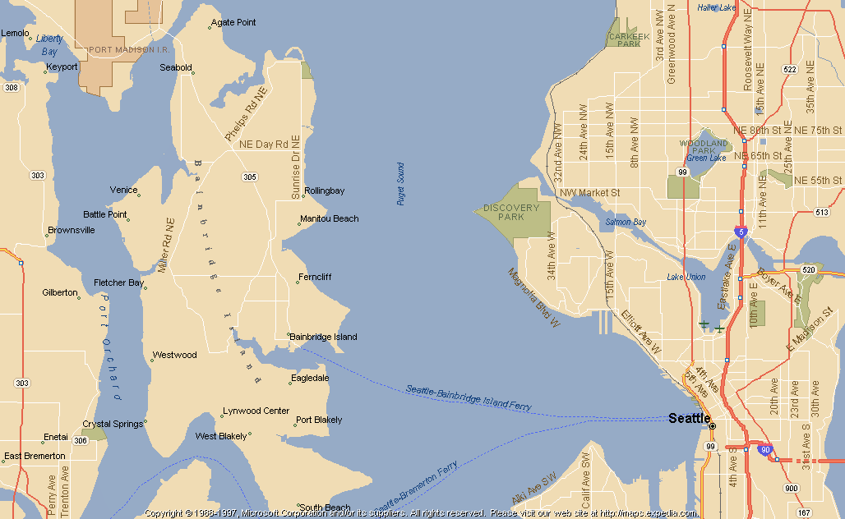
Target Areas
And my special place,
Bainbridge Island, in Washington State, 35 minutes by ferry from Seattle.

Slide 8
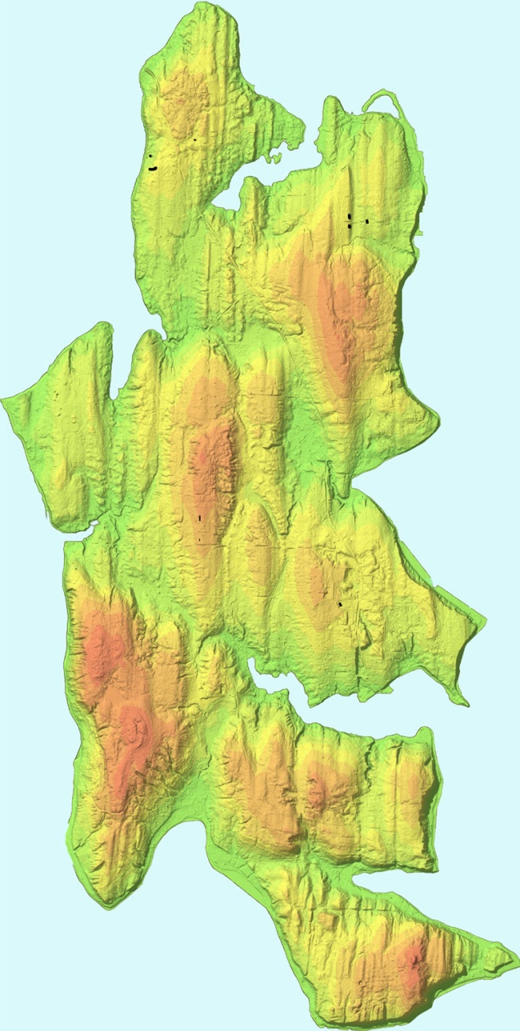
Glacial scraping left behind a remarkable geography on Bainbridge Island
47.6249° N, 122.5210° W
168 km² (65 miles²)
IslandWood is 91 hectares(225 acres)
Annual average temperature 10.6 °C (50.5 ºF)
Annual average rainfall 1032 mm (41 inches)
Annual average snowfall 50-75mm
IslandWood

Slide 9
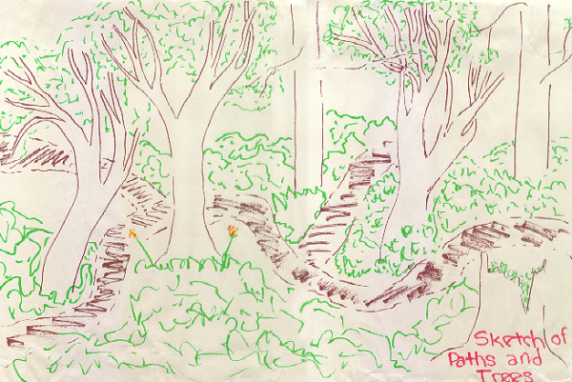
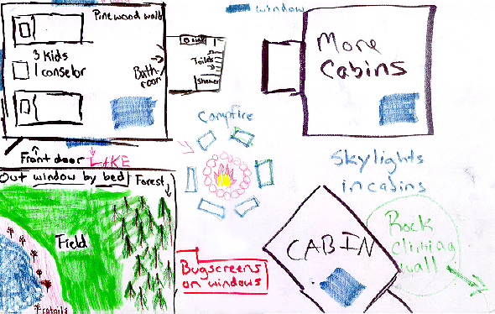
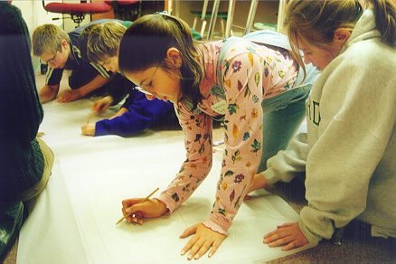
The vision for IslandWood in 1999 was for a place outside the city where all children could learn in the woods. Children’s design workshops helped us build IslandWood.
Notes:
Paul and Debbi Brainerd funded their vision generously, and were successful at engaging many donors to make this dream a reality.

Slide 10
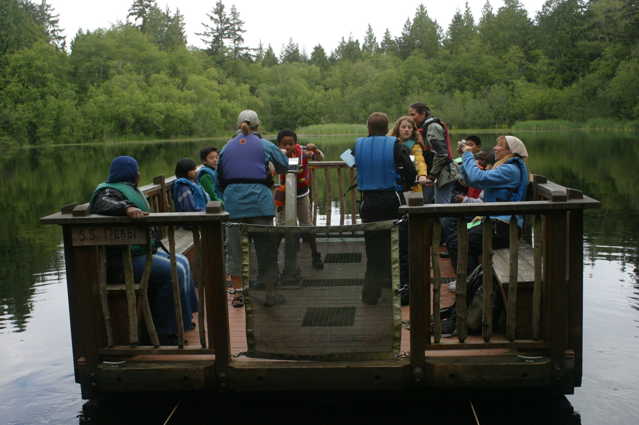
The children's ideas became the Floating Classroom…
Notes:
Floating classroom

Slide 11
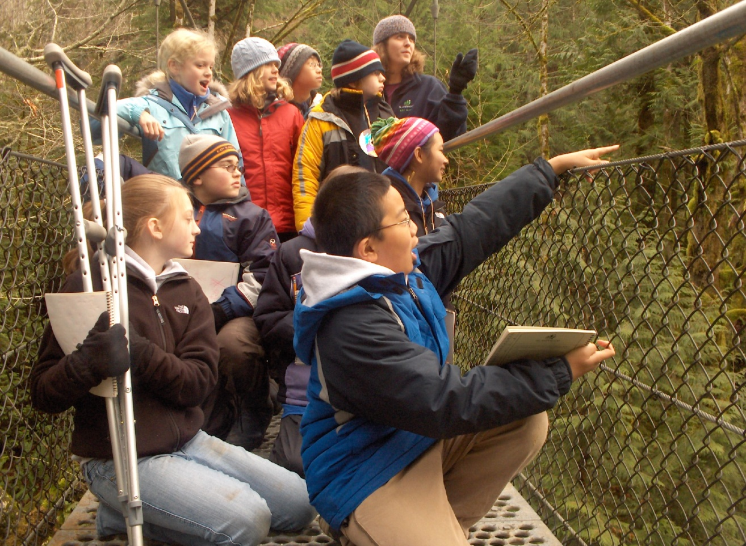
…the Suspension Bridge…
…the Suspension Bridge…
Notes:
Suspension bridge

Slide 12
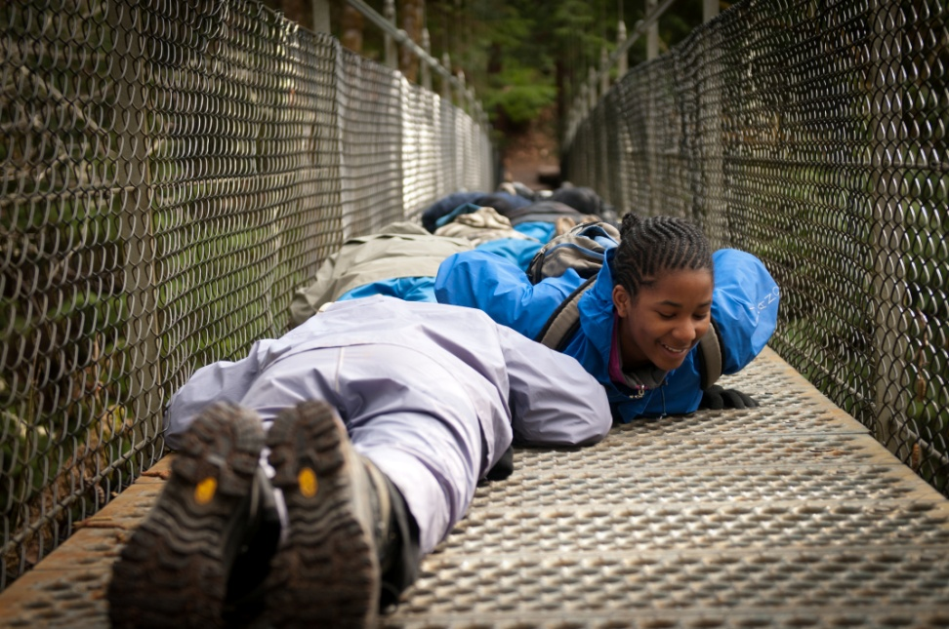
…the Suspension Bridge…
Notes:
Suspension bridge

Slide 13
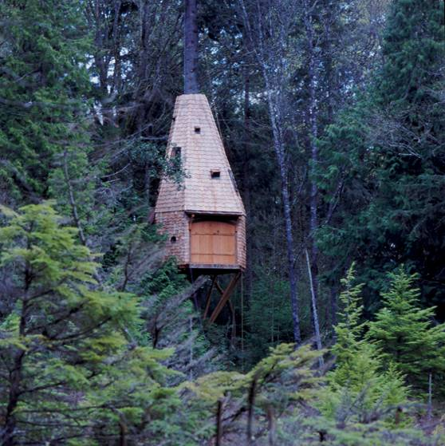
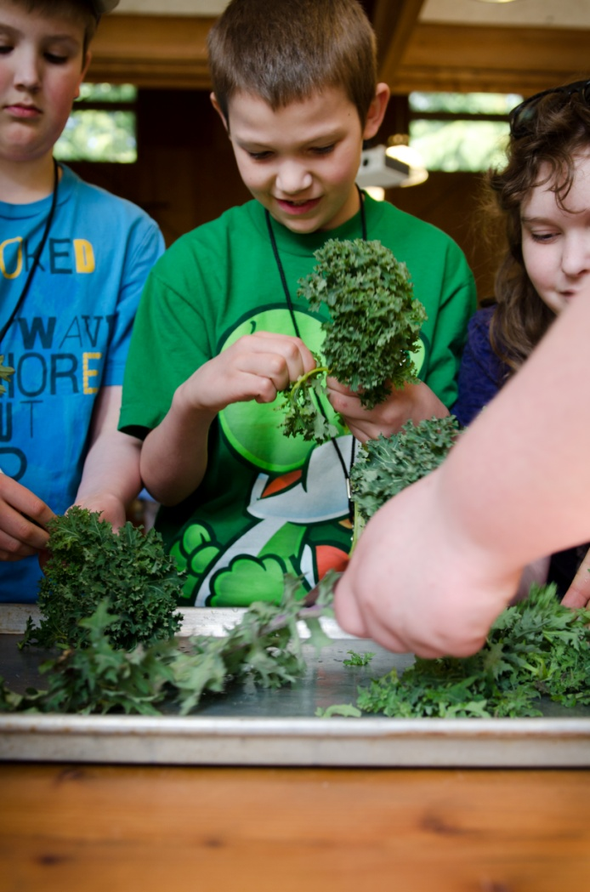
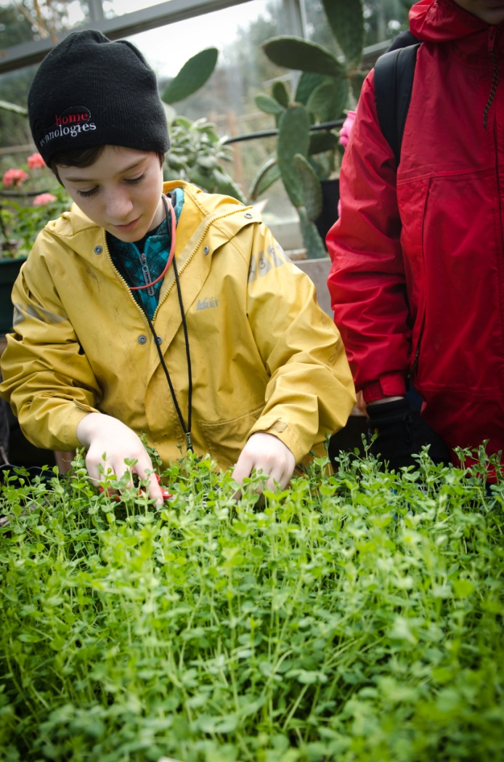
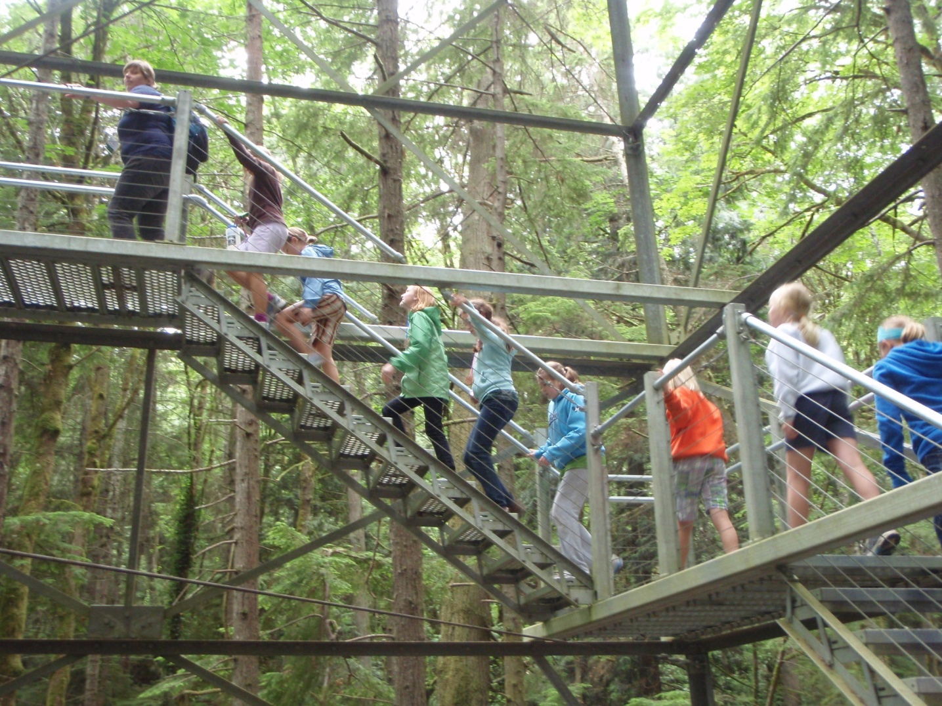
…the Garden.
Notes:
Suspension bridge

Slide 14
…the Canopy Tower…
Notes:
Suspension bridge

Slide 15
and the Bog Treehouse.
Notes:
Suspension bridge

Slide 16
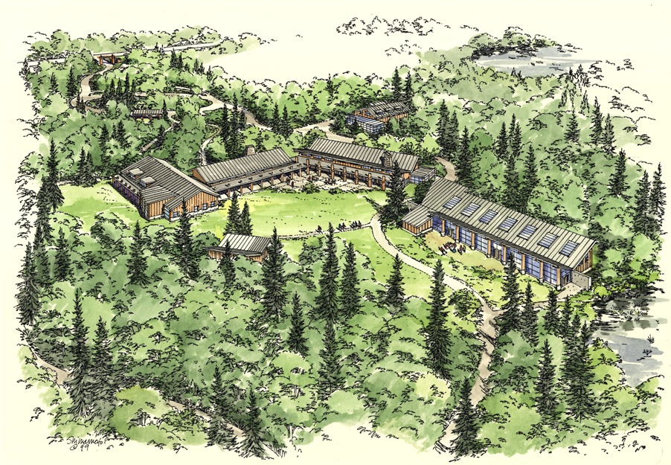
Sustainable design and construction practices were used to significantly reduce or eliminate the negative impact of buildings on the environment and occupants.
Gatehouse Entry
Dining Hall
Great Hall
Administration
Classrooms
Art Studio
•
To Teams Course
•
To Lodges & Friendship Circle

Slide 17
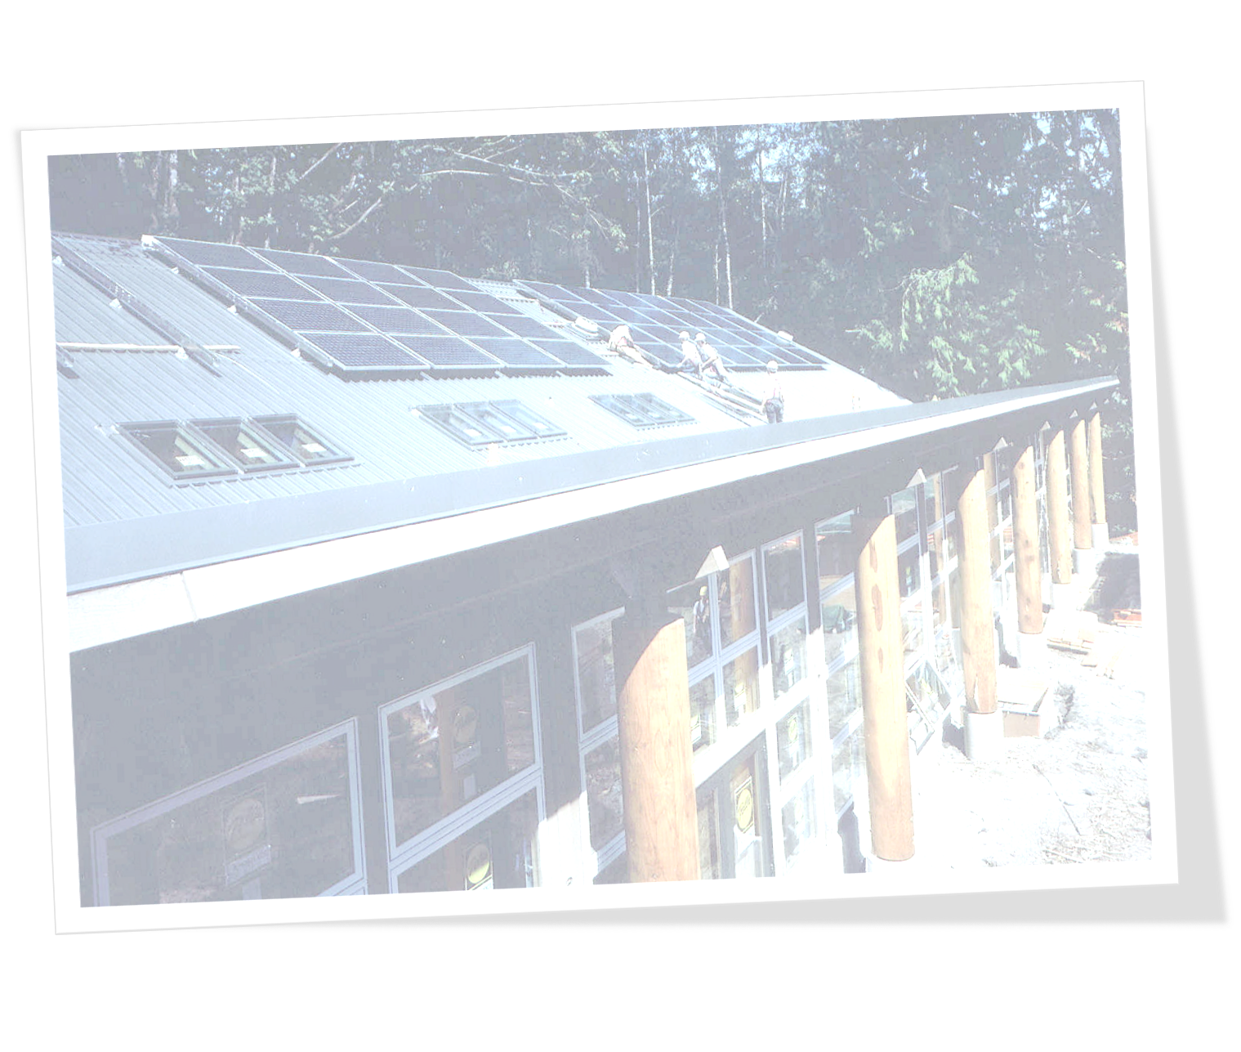
Sustainable Design
Buildings that teach
Feature healthy and sustainable materials
Use solar panels and composting toilets to reduce energy & water consumption by 50%
Are oriented towards solar meadows for passive solar heat and light
Have rainwater collection cisterns
“Living Machine” – wastewater treatment on site
Notes:
Structural: heat and energy conservation, flexibility in use of built structures (i.e.. Classroom design, friendship circle, gathering space).

Slide 18
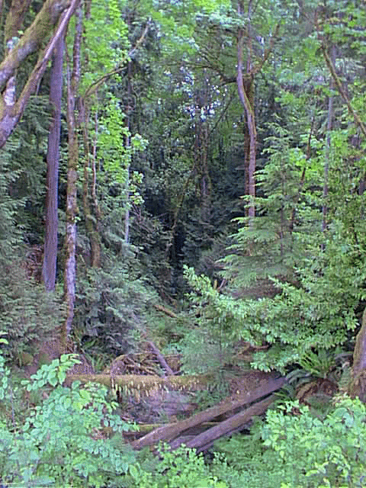
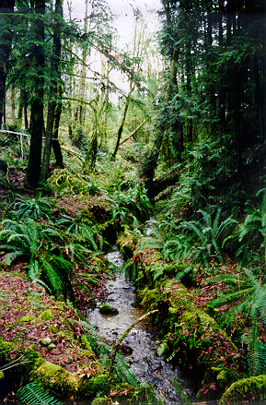
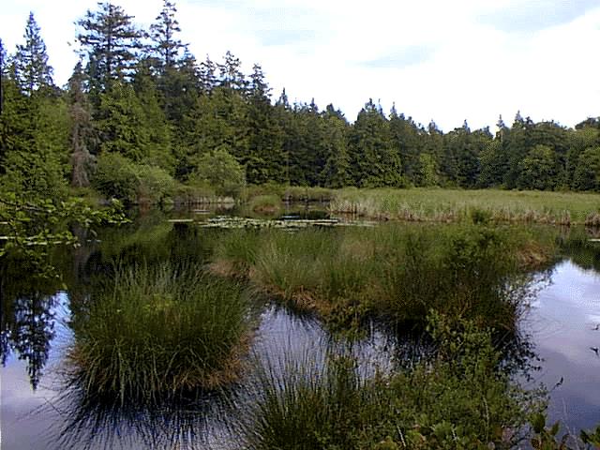
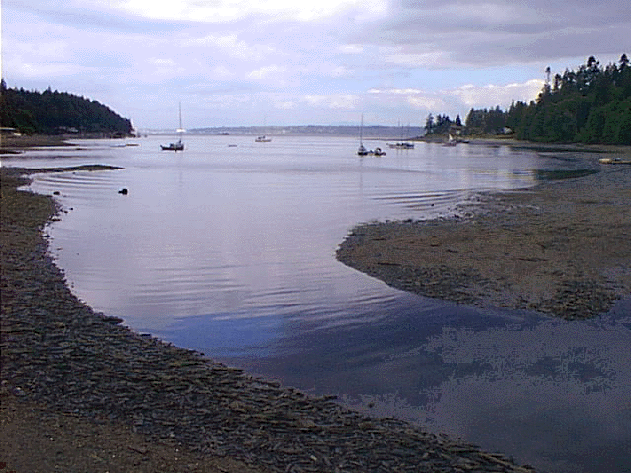
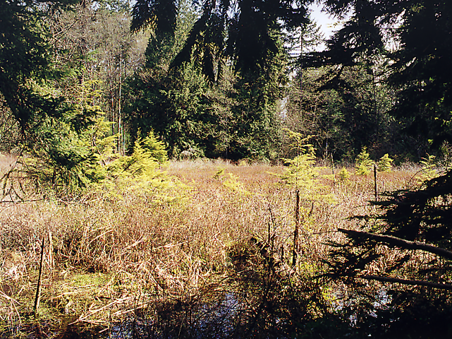
IslandWood’s Natural & Biological Assets
255 Acres
Complete Watershed
Six Ecosystems
Forest
Marsh
Pond
Stream
Bog
Estuary

Slide 19
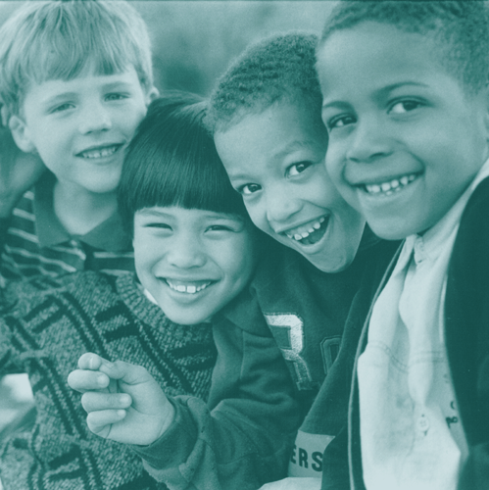
The School Overnight Program provides ecologically-based experiential education and:
-cultivates an
understanding
of cultural and
natural systems
-celebrates the
uniqueness of all
learners

Slide 20
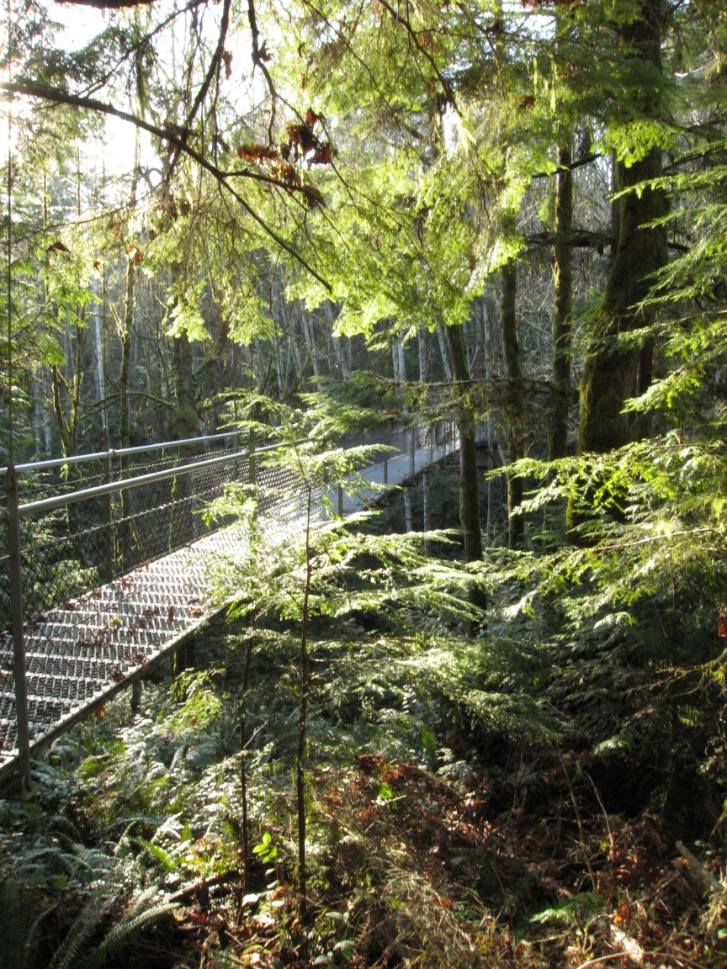
During the
4-day residential
program, the
focus is on the
natural areas
of the
IslandWood campus

Slide 21
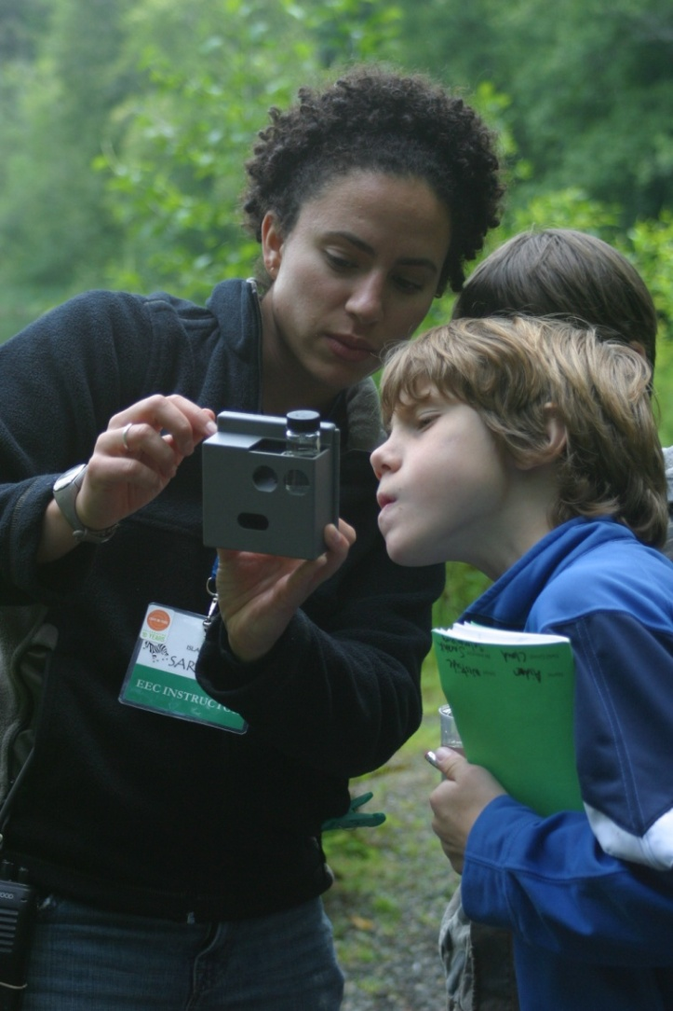
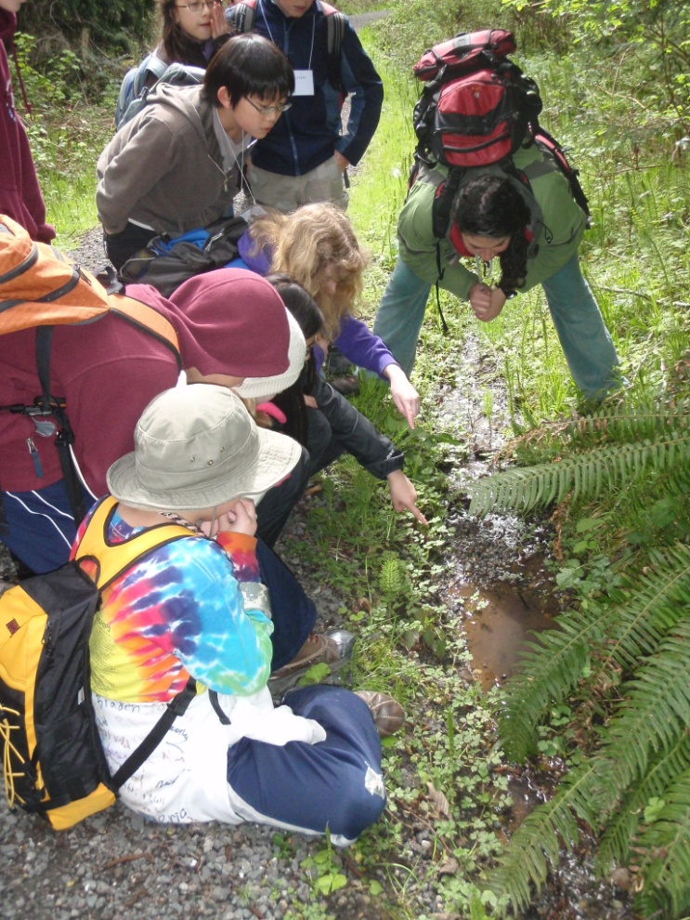
The School Overnight Program is the laboratory for the graduate students.

Slide 22
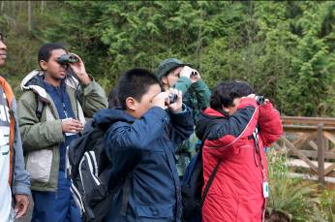
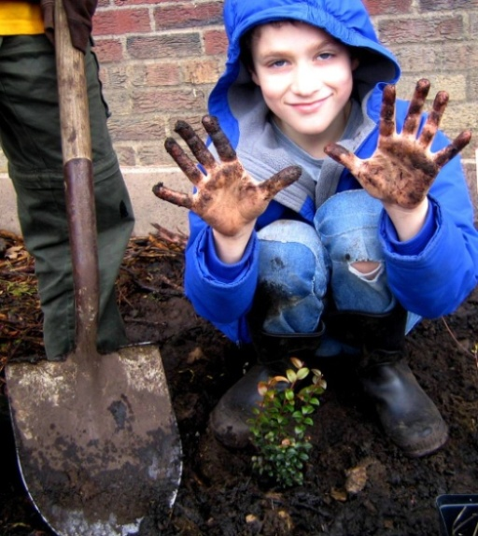
IslandWood prepares educators to address 21st century challenges by using the environment as a context for teaching and learning. This is done in the School Overnight Program.

Slide 23
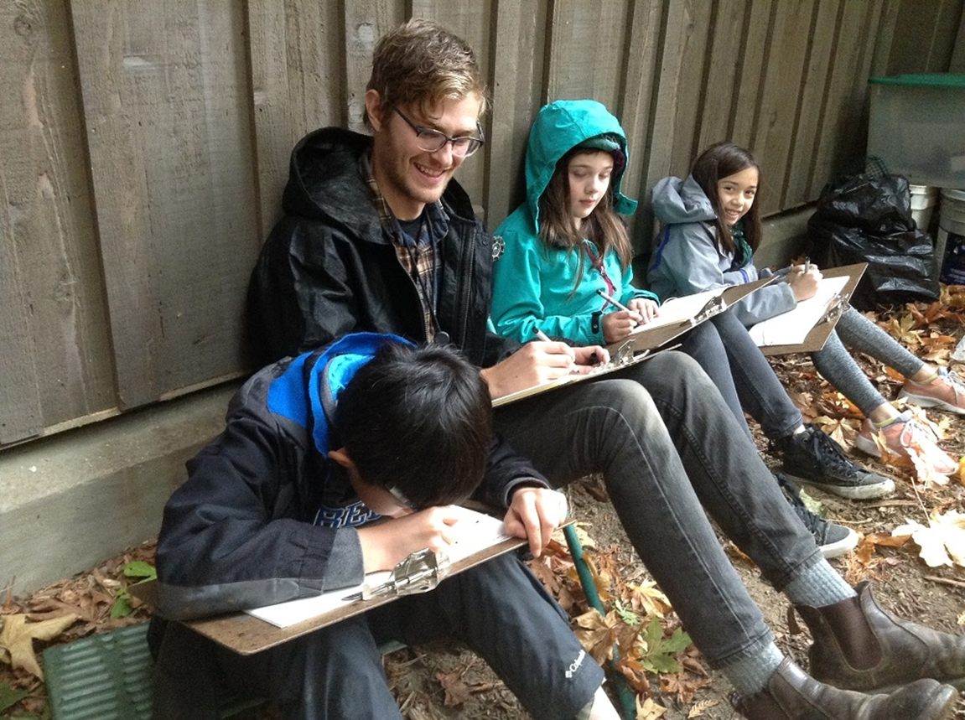
What happens at IslandWood?

Slide 24
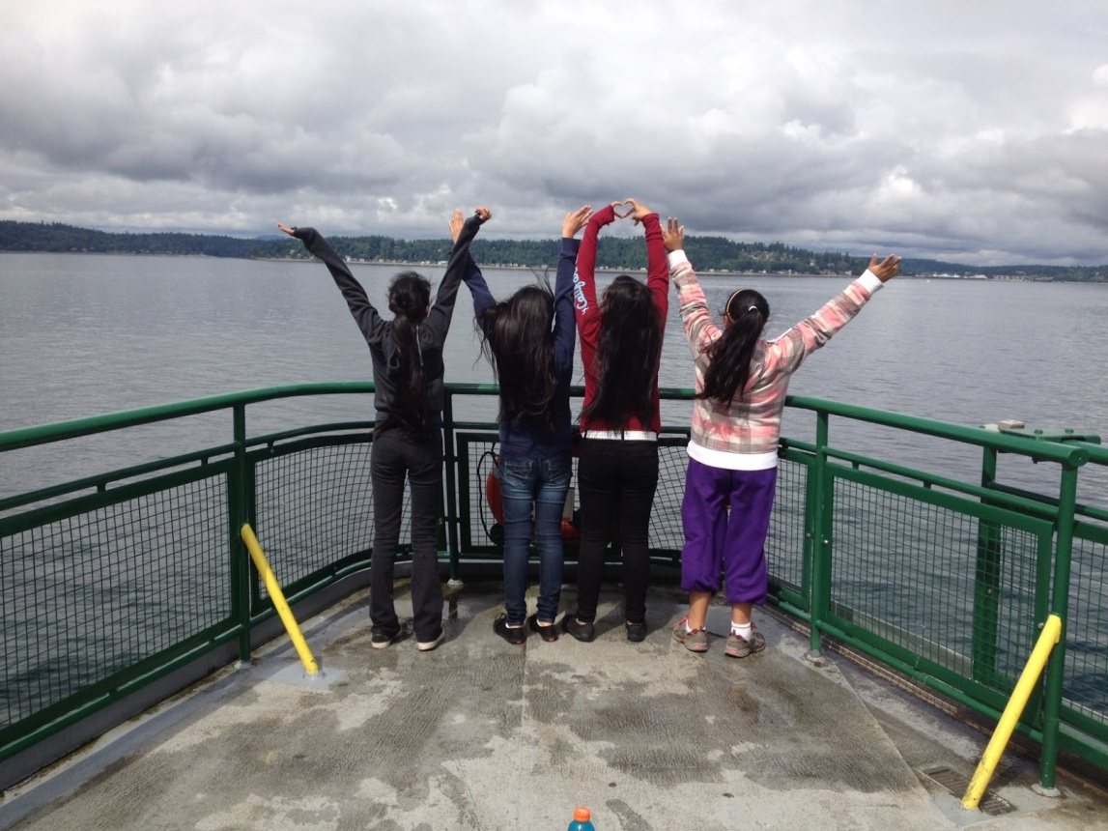
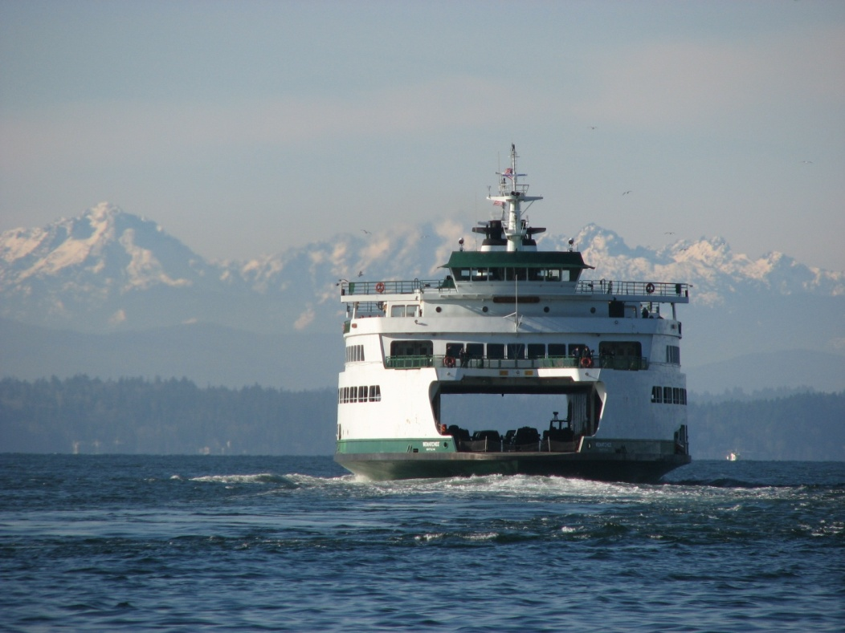
Most students arrive by ferry

Slide 25
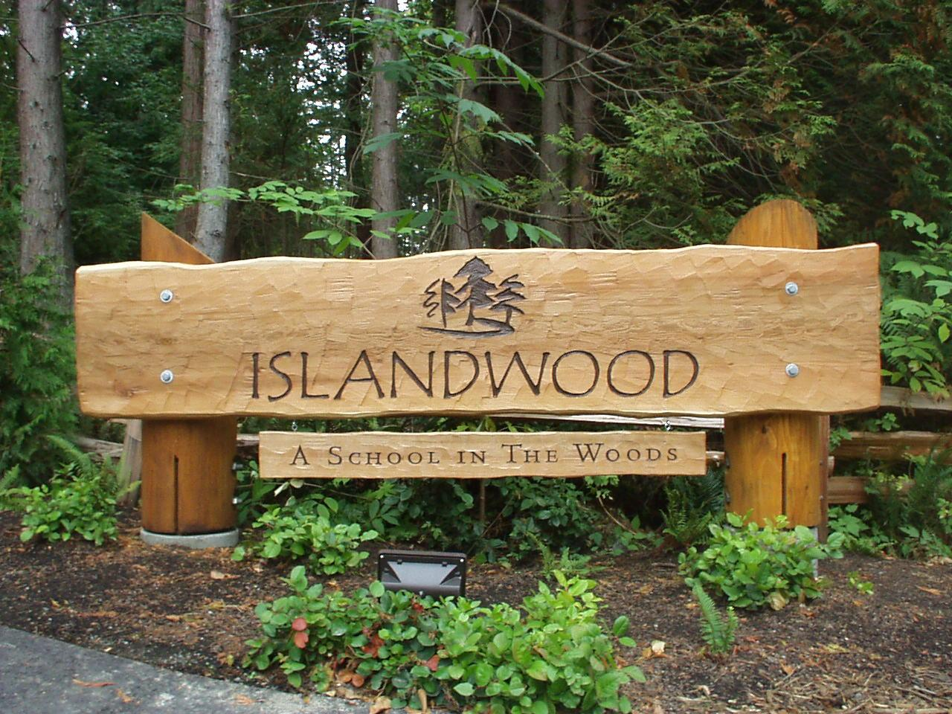
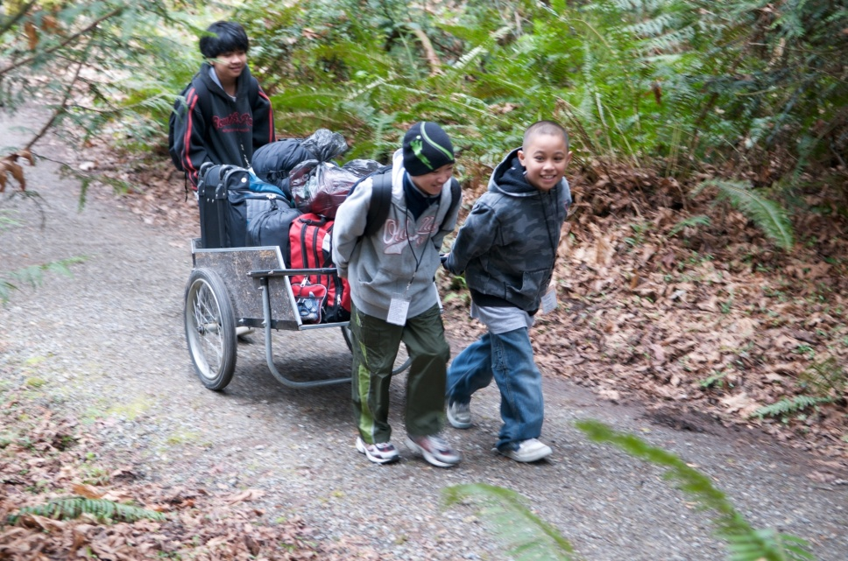
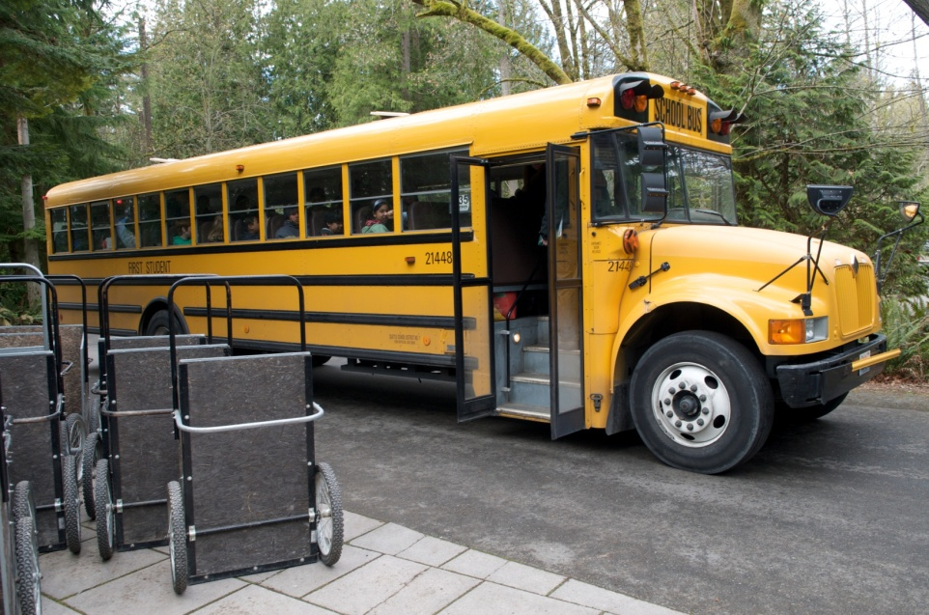

Slide 26
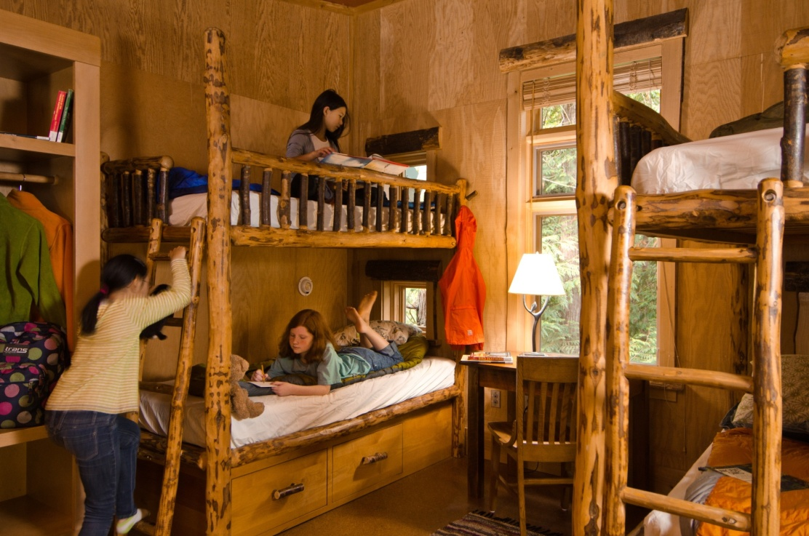
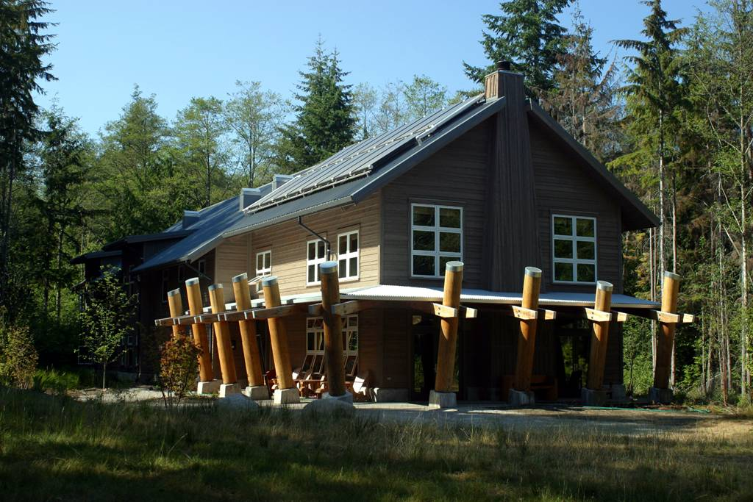
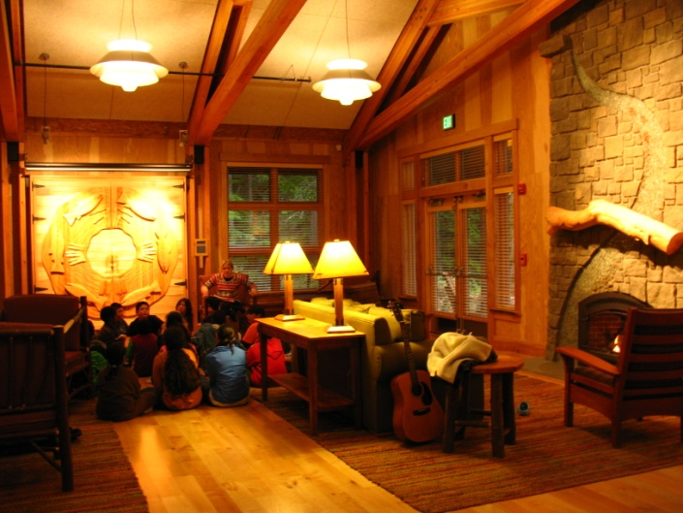
They move into their lodges with their teachers and parent chaperones

Slide 27
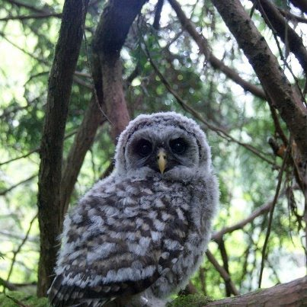
Curriculum is Integrated and Interactive

Slide 28
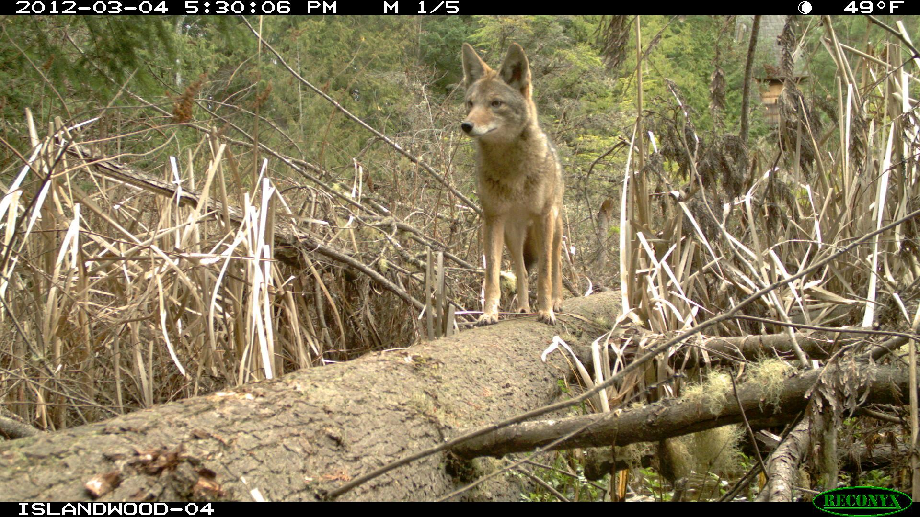
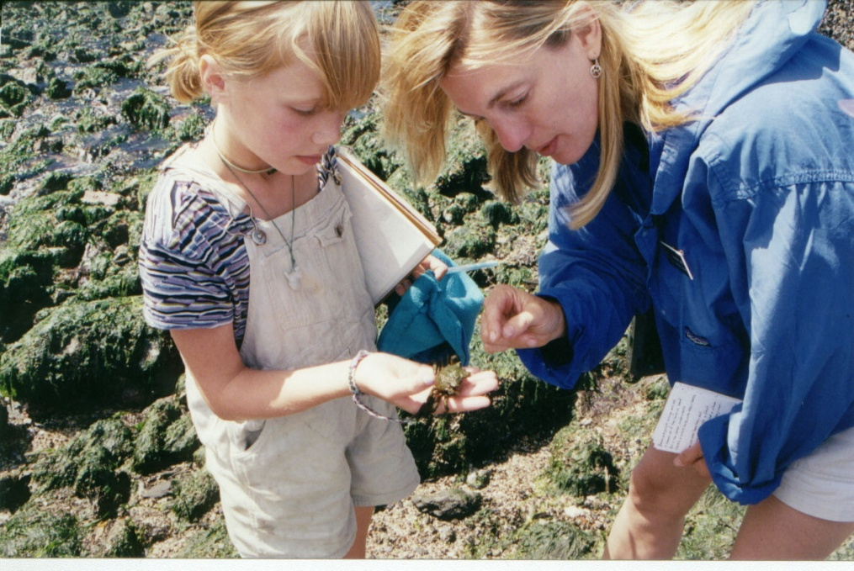
Linking Natural History…
Canis latrans

Slide 29
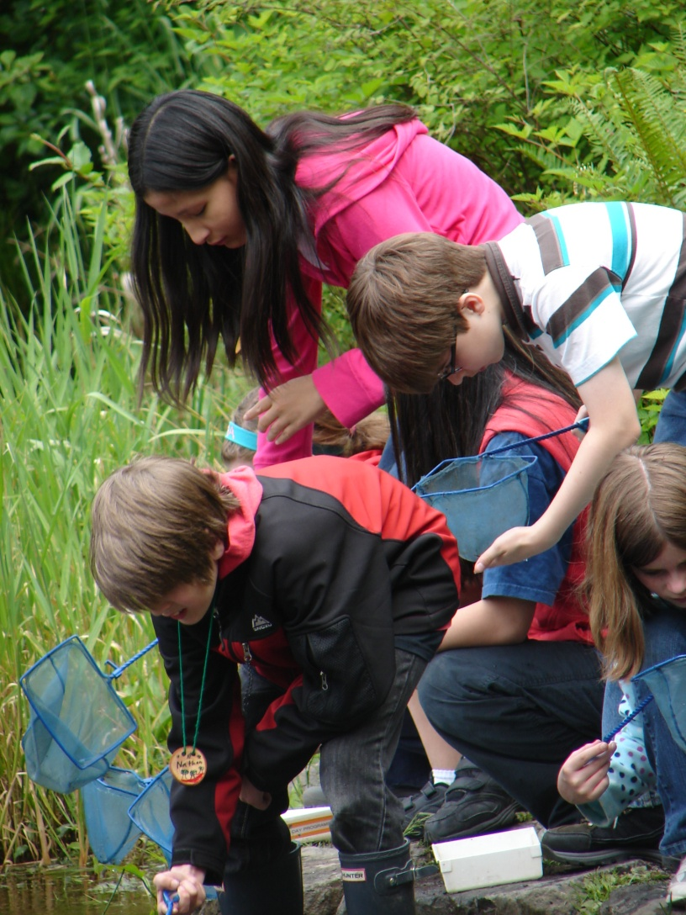
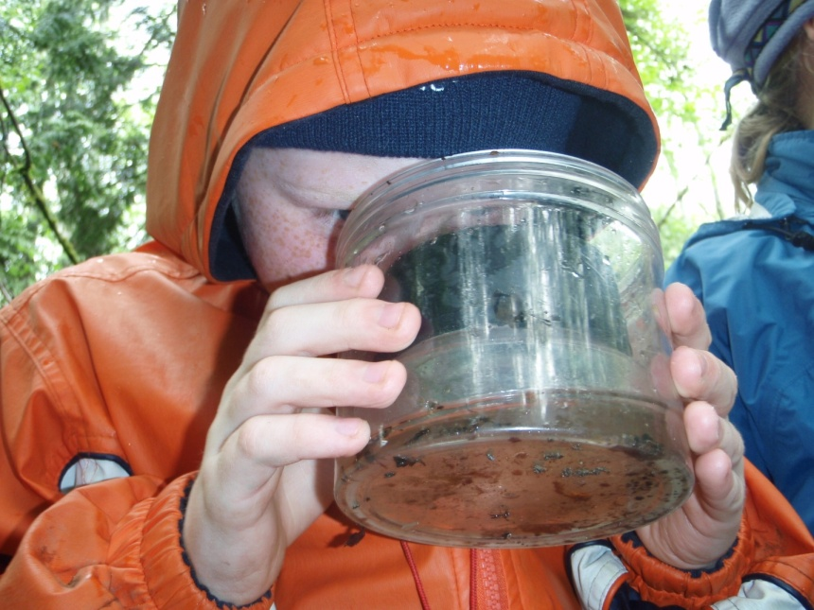

Slide 30
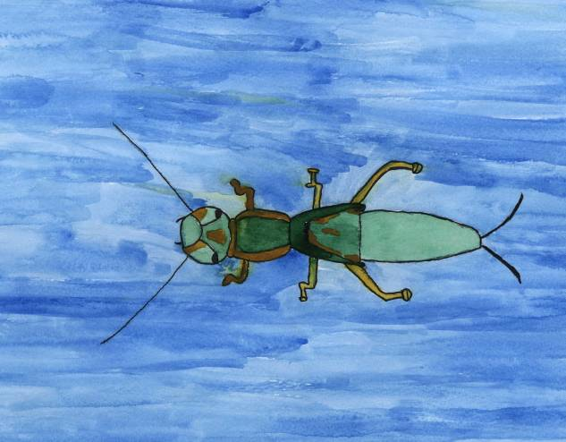
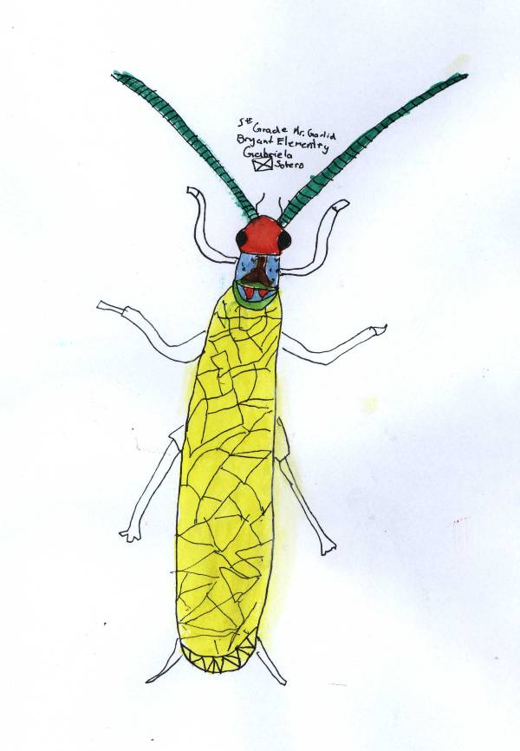
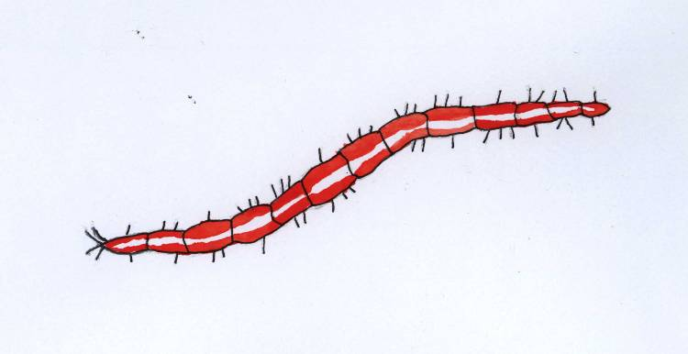
Notes:
Scientific Drawings
Again, we try to reach multiple learning styles, and at IslandWood we MAKE LEARNING FUN. We use art, science, and tech because they are hands-on. Here are some scientific drawings of insects at IslandWood.

Slide 31
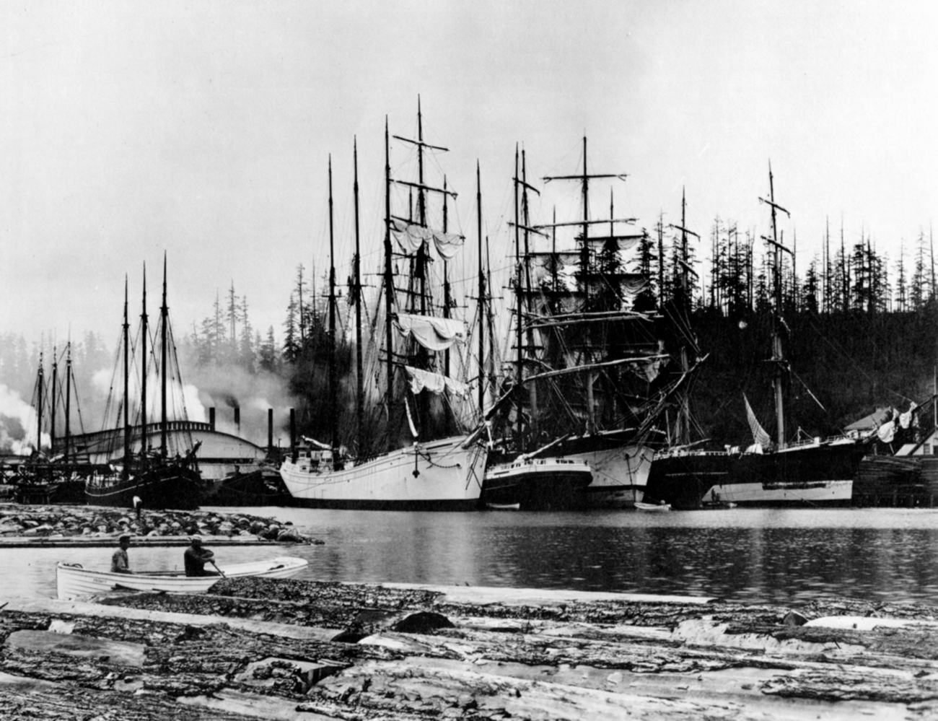
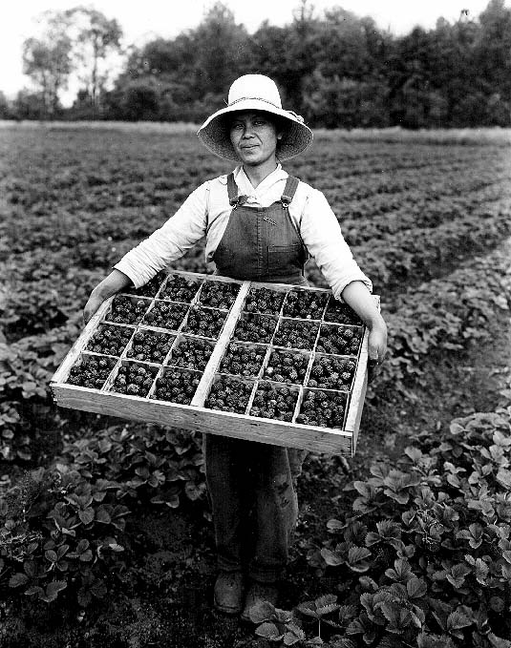

…with Cultural History.

Slide 32


Bringing artists to work with children

Slide 33




Slide 34


and scientists to share research

Slide 35




Connecting garden soils…

Slide 36



…to our food
Notes:
IslandWood’s kitchen staff prepares healthy, kid-friendly food that is sensitive to all religious, dietary, and allergy needs. Children receive three meals a day, plus snacks.

Slide 37



and our health

Slide 38


Building community

Slide 39


Slide 40


Slide 41


Through partnerships with schools…

Slide 42



…learning transfers from IslandWood back to school communities.

Slide 43


Results of the School Overnight Program
Day 1
Day 4
Notes:
Pre and post assessments of children in the residential 4 day program

Slide 44

Studies show that, almost to a person, conservationists or any adults with environmental awareness, had some special experience in nature when they were children.

Slide 45

For some, the epiphanies took place in a national park; for others, in the clump of trees near their homes, or even a roadside ditch.
But if experiences in nature are not available for future generations, where will stewards of the Earth come from?

Slide 46

"This is an opportunity for children to discover not only who they are, but to discover where their strength comes from. An opportunity like that can change the lives of the kids."
-Marjorie Lamarre
5th grade teacher,
John Muir Elementary

Slide 47



Urban Environmental Education
Seattle
Education for Environment & Community
Bainbridge Island
Notes:
The second main program is our graduate program, with 2 distinct offerings. One is residential, located on the the IslandWood campus, and the other is urban based in Seattle.

Slide 48

Master of Arts in Education (M. A. Ed.)
in Urban Environmental Education
City as Classroom, Urban Ecology, Justice & Equity, Community Education
Five quarters of integrated academics in Seattle, WA, credits from Antioch University
A nine-month, paid community based practicum
Teaching through various community based organizations
Rethinking traditional environmental education for an urban context

Slide 49

Graduate Certificate in
Education for Environment & Community
Living, Learning, and Teaching in the Pacific Northwest
Ten-month mentored residency on Bainbridge Island, WA
Teaching the IslandWood School Overnight Program
Work with Puget Sound-area elementary schools
Learning the best practices of experiential, environmental, and multicultural education
Options to complete your degree at the University of Washington

Slide 50

"As educators, we need to build stories that young people can imagine themselves in. As urban environmental educators, we help build strong narratives that acknowledge the built environment and put youth firmly into the center of it, bringing value to their engagement in its unfolding future.“
-Lenny Haynes
Urban Env. Education Alumnus

Slide 51




Program numbers
4,400+ children in our School Overnight Program from 90 schools
"
Workshops serve several hundred teachers in the region
8,000+ kids, adults, and families in summer and weekend programs
4250 Adults at Conference Events
4600 all ages in
23 Community Events on Bainbridge Island
Notes:
140 teachers in school overnight program too.

Slide 52

Notes:
contributions: donors, both individual and corporate, foundations and grants
program fees: graduate programs, events (weddings, retreats, etc), School Overnight Program

Slide 53


Slide 54

Thank You!
“Those who contemplate the beauty of the earth find reserves of strength that will endure as long as life lasts.”
-Rachel Carson
“Imagination is more important than knowledge.”
-Albert Einstein

